Slide 1
Overview: Identification and Seizure of Electronic Evidence

Slide 2

Objective
By the end of this module, participants will demonstrate the ability to properly seize electronic evidence.
Notes:
Properly seize, it includes documentation, bag and tag, chain of custody.

Slide 3
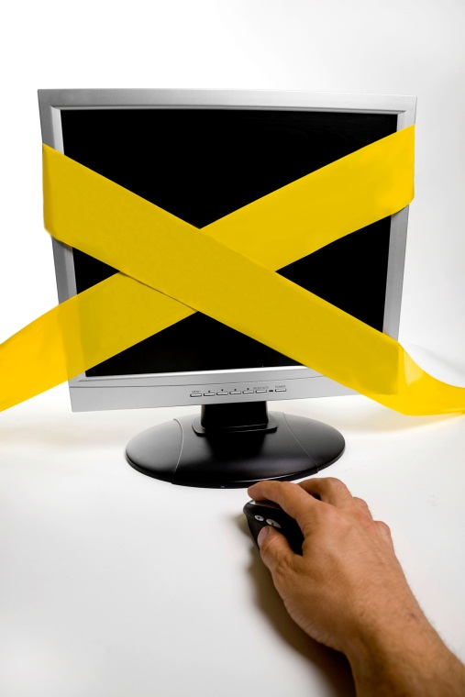
Responder’s Role
Identify all potential electronic evidence at a crime scene
Seize the evidence in a manner that supports the investigation and prosecution
CRIME SCENE
Notes:
In a manner that the evidence is preserved and documented.

Slide 4
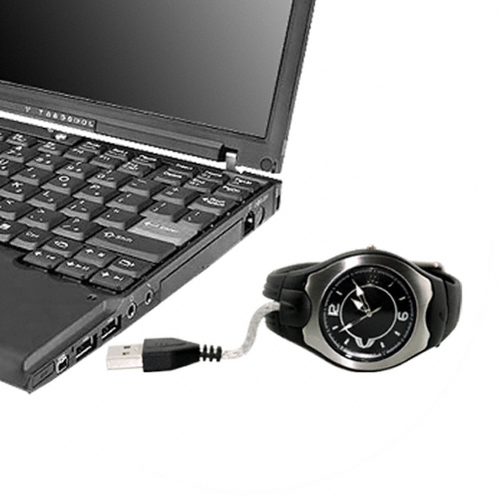
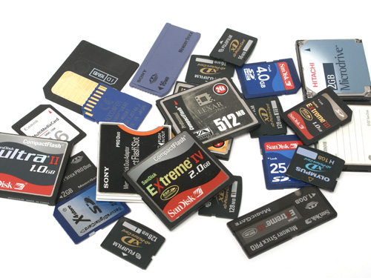
Identification of Electronic Evidence
Electronic evidence evolves with advances in technology and market demand
Training and awareness by the first responder are critical for identifying evidence
Notes:
With the advent and advancement of information technology, a lot of new electronic gadgets in the market today that may be used as a tool or storage for any criminal activity.
Such as a USB watch, wherein employees may use it to steal information from your company. Or with the variety of removable storage media in different sizes, it is easy to conceal.

Slide 5


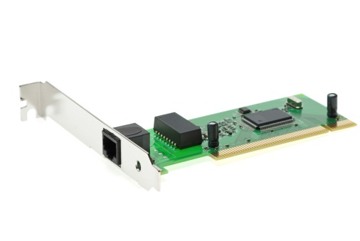










Computer Hardware
Notes:
Tangible components of a computer:

Slide 6















Computer Software
Notes:
Any data that can be stored electronically
Hardware and software work together enabling a computer to function as a system

Slide 7

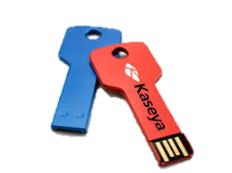

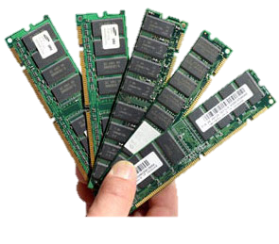
Where Is the Evidence?
Digital Evidence
Non-volatile data
Volatile data
Notes:
With the advent and advancement of information technology, a lot of new electronic gadgets in the market today that may be used as a tool or storage for any criminal activity.
Such as a USB watch, wherein employees may use it to steal information from your company. Or with the variety of removable storage media in different sizes, it is easy to conceal.

Slide 8
Computer Crime Scene
Preservation and Documentation

Slide 9

Traditional Crime Scene
Notes:
Same as the traditional crime scene, computer crime scene should also preserve the way the traditional crime scene.

Slide 10

Computer
Crime Scene

Slide 11

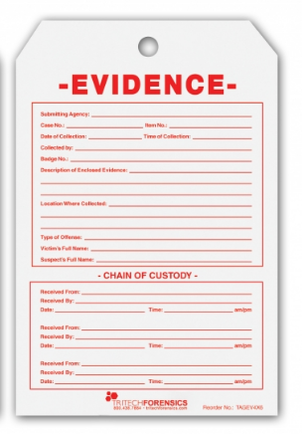
Documentation
The first responder must document all steps taken on the scene
Documentation:
Continues through the investigation
Does not stop until case completion
Notes:
Accountability/chain of custody:
Is started for every piece of evidence collected at the scene
Tracks possession of evidence
The documentation should detail all actions taken during each phase of the digital forensic process:
Identification and seizure of digital evidence
Acquisition of digital evidence
Analysis of digital evidence
Report on findings

Slide 12


Collection of
Volatile Data

Slide 13
Collect Volatile Data
Resides in temporary storage media and is lost when power is removed
Could contain evidence of actions occurring on the system at the exact time of seizure
Must be collected quickly at the crime scene using validated tools and proper procedures
Notes:
Whenever you run a program (e.g. operating system, applications) or open a file (e.g. videos, images, music, documents) it is loaded temporarily from the hard drive into your RAM.
- Computer date and time, current user logged in, running application and processes.
Once loaded into RAM, you will be able to access it smoothly with minimal delays.
The data are stored randomly on the RAM and it can be assessed directly.
If you run out of RAM, your operating system will begin dumping some of the open programs and files to the paging file causing your computer to lag (swap or page file)
This data could contain valuable information about the actions occurring on the system at the time of seizure, such as:
Network connections
Passwords
Data included in open documents
Internet-based data (chats, email, and browsing activity)
Running processes

Slide 14
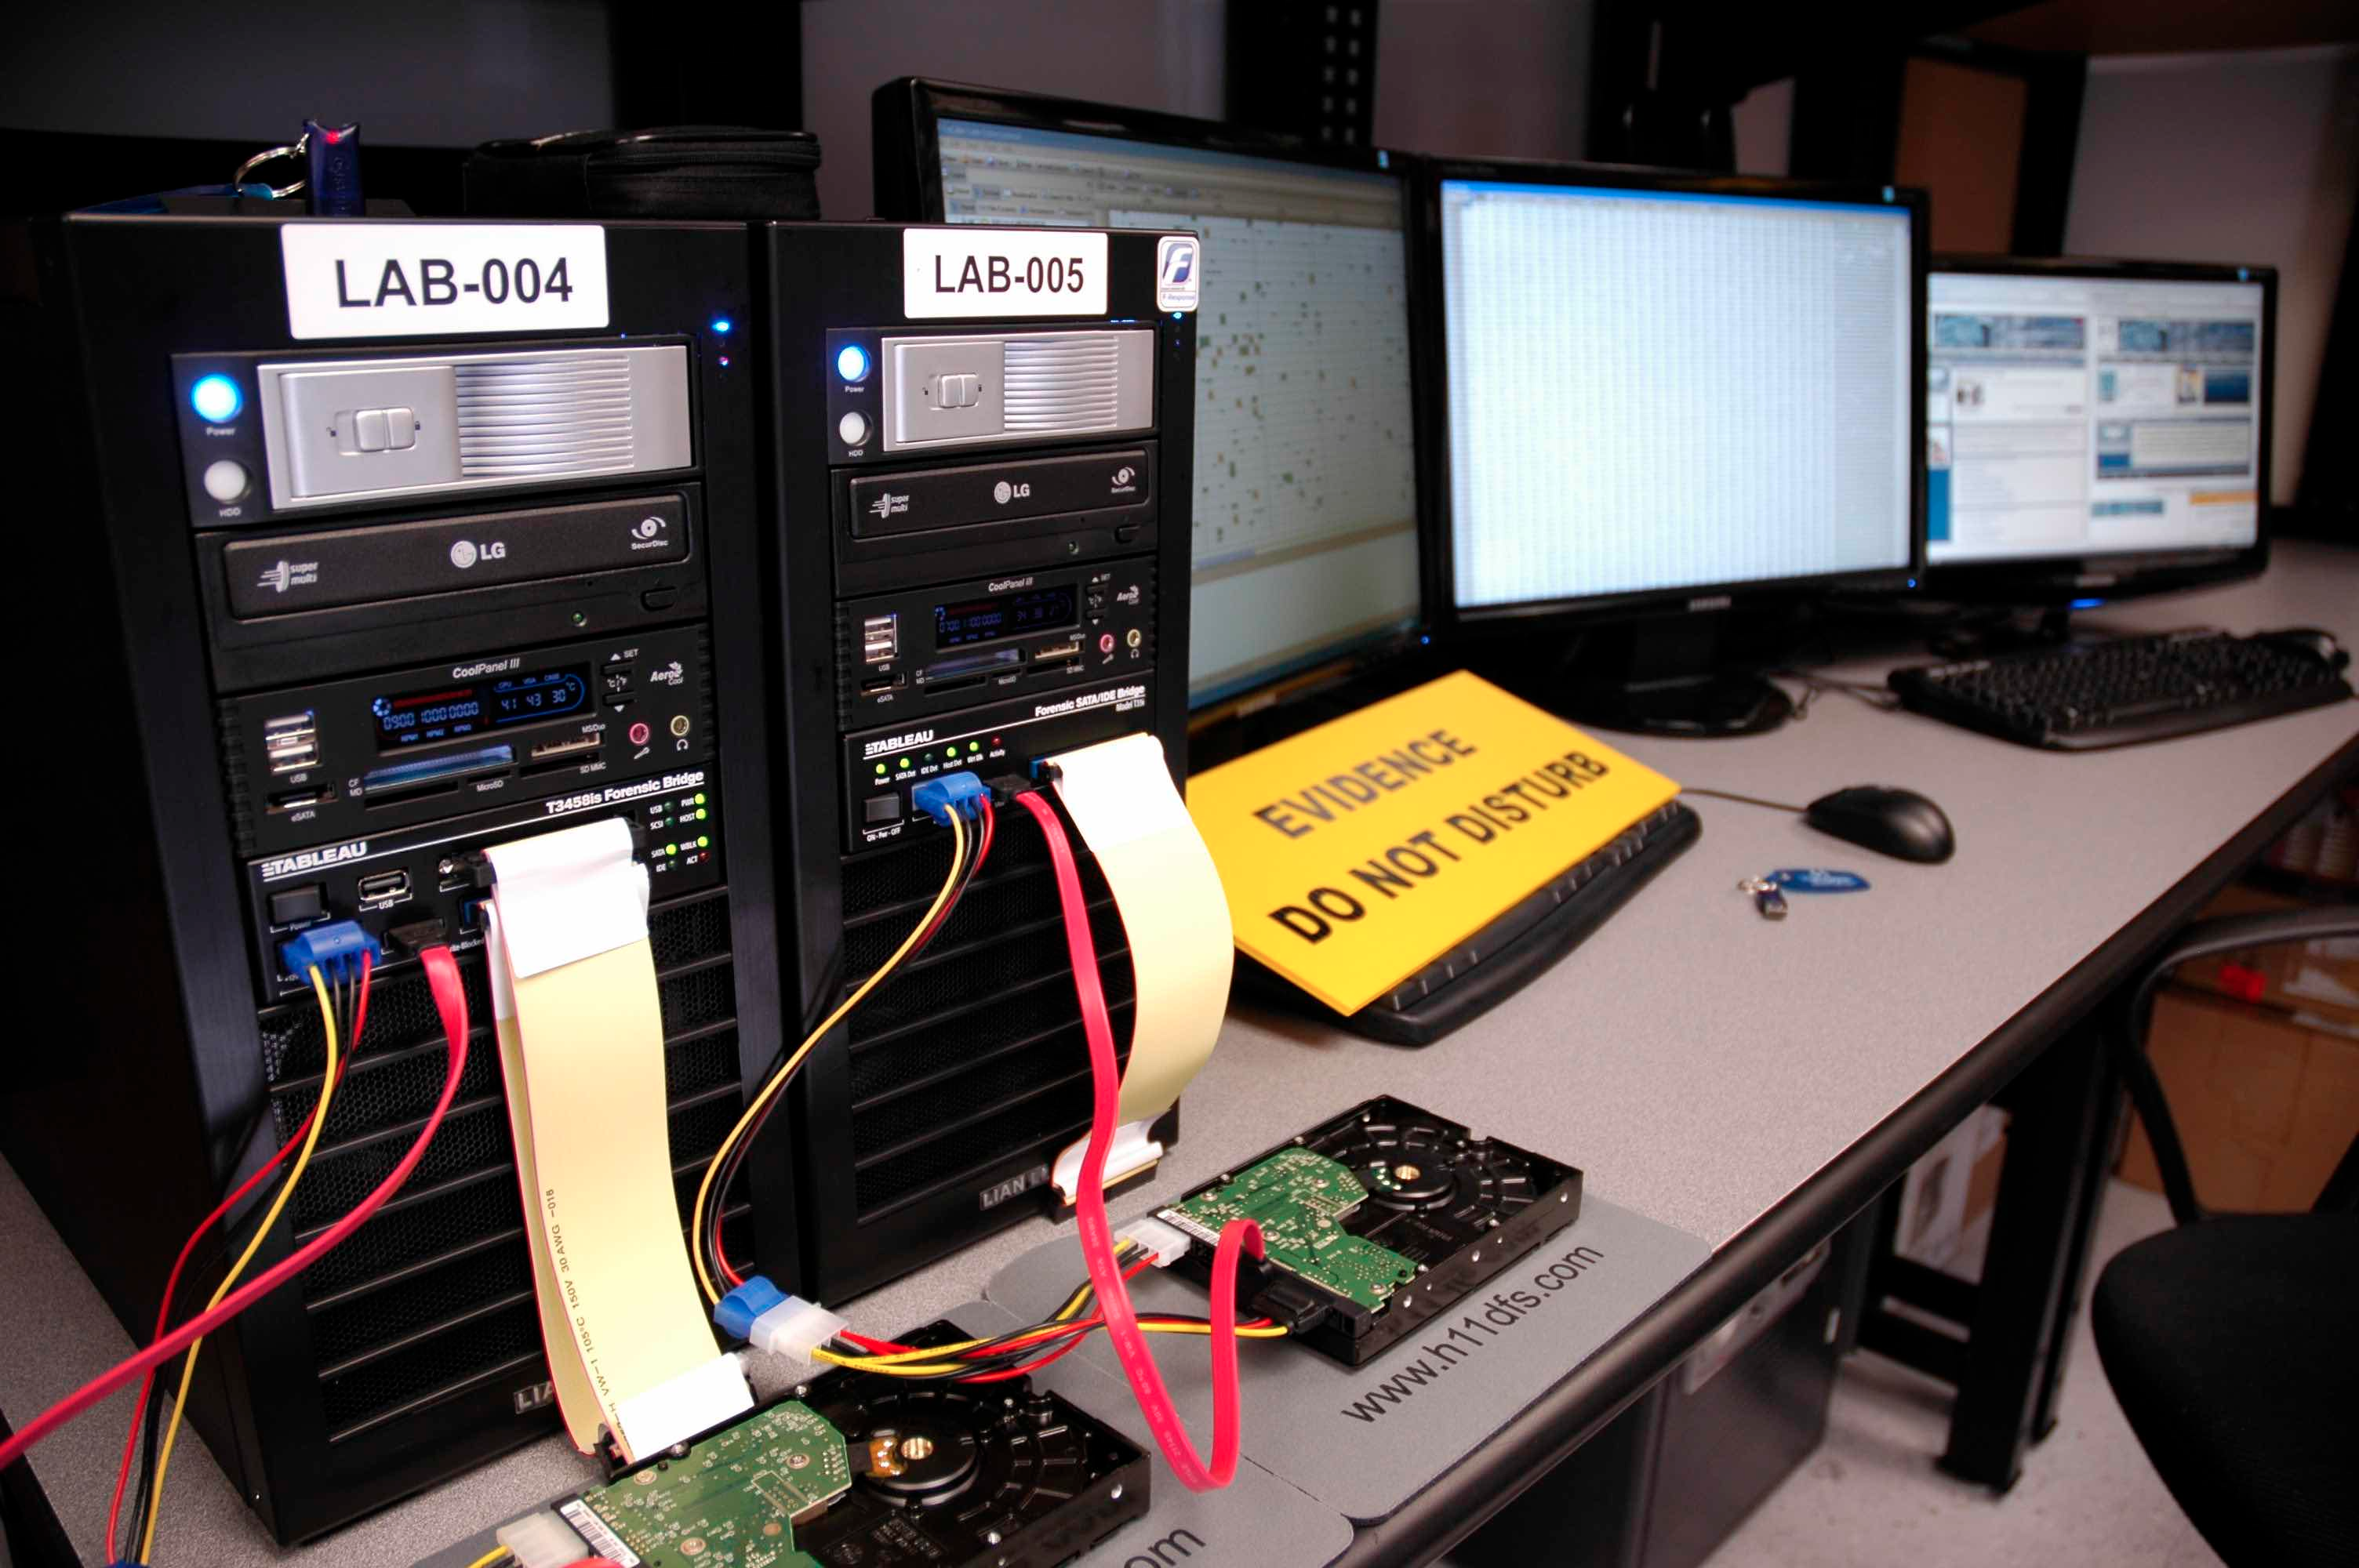
Forensic
Imaging

Slide 15
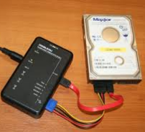
Forensic Imaging
Non-volatile data resides in persistent storage media
The first responder must understand legal and technical boundaries
Can you legally obtain a forensic copy of source media?
Does obtaining a forensic image make sense?
If so…which kind? Logical or physical?
Do you have the tools to properly obtain the image?
Notes:
Forensic Imaging or Acquisition
Forensic Imaging
Forensic imaging is the process of producing a forensic copy of data stored on volatile and non-volatile storage media. Non-volatile data is information that is persistently saved to digital storage media and will be preserved after power is removed from the system.
Traditionally, there are two kinds of images that storage media can produce:
Physical Image – a forensic copy of all data stored in every addressable sector of digital storage media
Logical Image – a forensic copy of all data stored in every addressable sector of a hard drive partition
Forensic imaging can be applied to all types of storage media, including traditional hard drives (3.5” and 2.5”) and the multiple form factors that make up removable storage media. The first responder must consider the following questions and challenges with respect to creating a forensic image:
Can the responder legally obtain a forensic copy of source media? If so, is he or she limited to the data contained on just one partition? Is he or she limited to a folder saved to that partition?
Does obtaining a forensic image make sense? What if the source system is a multitenant configuration and belongs to a cloud storage provider? In this case the storage capacity could be extremely large (+1 Tb) and configured as a redundant array of independent disks (RAID) or spread across multiple servers. In this case would the responder obtain an image? The data in question could be a very small subset of the storage capacity. Therefore, collecting a forensic copy may not be logical. In that case, the first responder must develop a strategy to acquire the data in question.
Should the responder collect a physical or logical image of the storage media? The answers to this question may not be straightforward. As an analyst, ideally you would want a physical image that gives you access to unallocated data across the entire drive. However, what if the storage solution is a RAID or located elsewhere? The first responder might not be able to or want to collect a physical image, as it adds no value to your investigation. Collecting a forensic copy of logical volumes might be the better solution in such cases.
Does the first responder have the proper tools to collect a forensic copy from the storage media of the source system? Maintaining the integrity of the data is of utmost importance and should direct each action. Failure to use validated forensic tools to interface with the source system could compromise the digital evidence and your investigation.

Slide 16
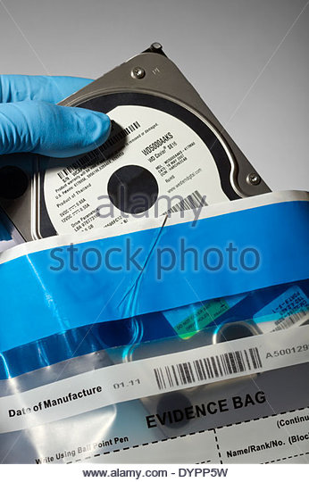
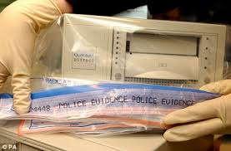
Process Physical Evidence
Execute “bag and tag” procedures to transport seized items
Computer hardware
Collected software
Volatile data
Triage data
Forensic Images collected on-scene

Slide 17

Troubleshooting
The first responder must:
Have problem solving skills and patience
Consider:
How to collect physical/digital evidence
The benefit of using a specific tool or technique
How to avoid contaminating evidence

Slide 18

Summary
The proper collection of physical/digital evidence is one of the most important aspects of the digital forensics process
If this collection is not done correctly, critical evidence can be lost

Slide 19
Thanks!
Any questions?

